Slide 1
QUARTERLY REPORT
DSU FINANCIALS

Slide 2
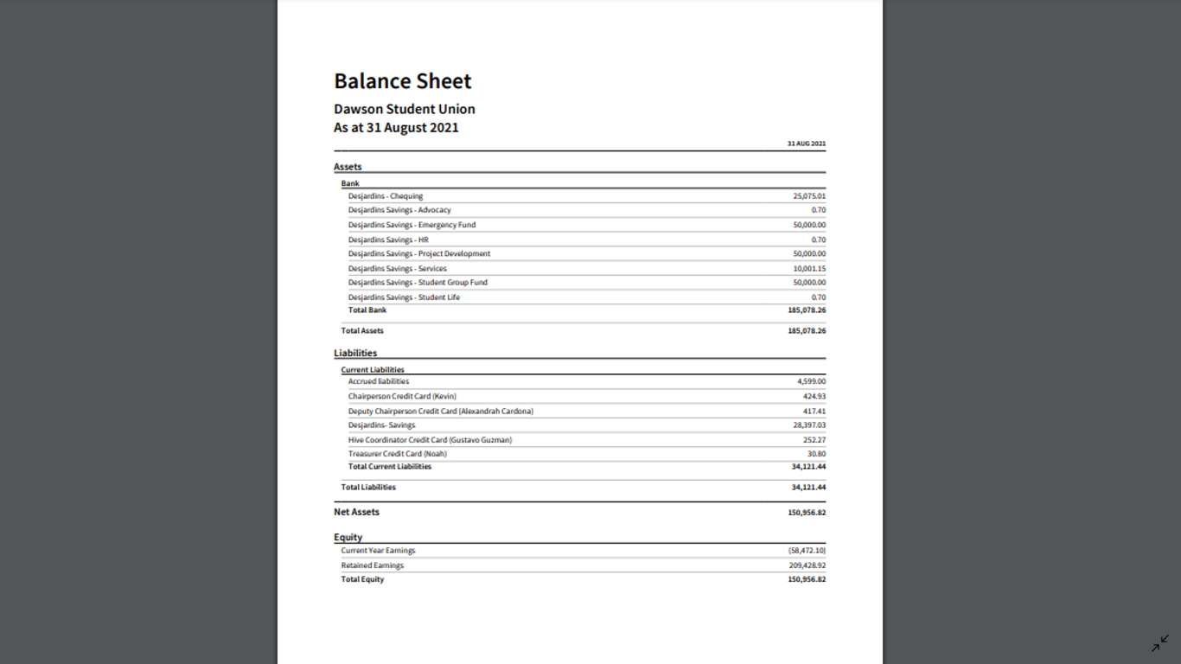
BALANCE SHEET

Slide 3
STATEMENT OF CASH FLOW

Slide 4
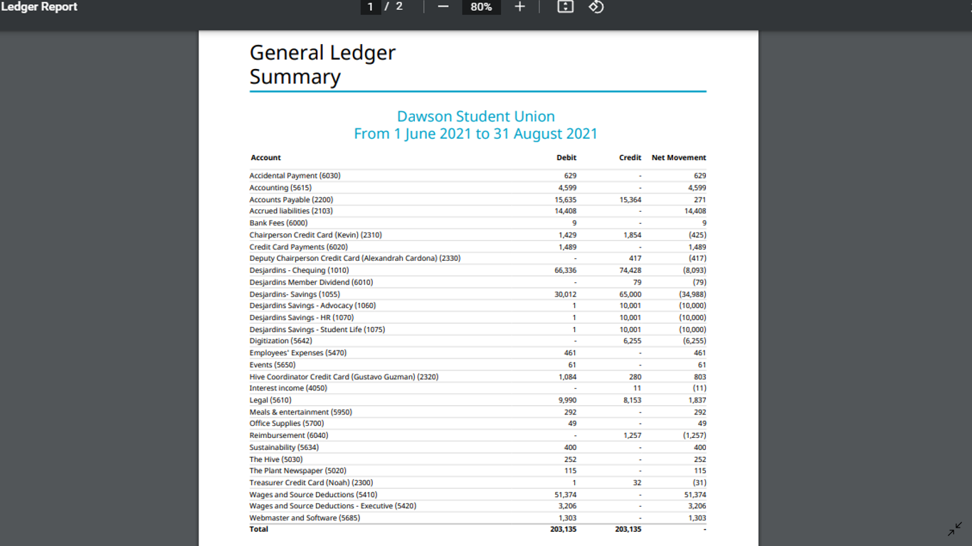
GENERAL LEDGER

Slide 5
GENERAL JOURNAL REPORT

